Slide 1


ISLAMIC MICROFINANCE COOPERATIVES
TO MEET THE FINANCIAL NEEDS OF THE CoMMUNITY
AL BARAKAH
multi-purpose Co-operative Society Limited
MAURITIUS
7TH GLOBAL ISLAMIC MICROFINANCE FORUM
24-25 NOVEMBER 2017 – ISTANBUL, TURKEY

Slide 2
AGENDA
Microfinance & Models of Conventional Microfinance
What is Islamic Microfinance?
Global Models of Islamic Microfinance
Evolution of Islamic Banking, Finance & Islamic Microfinance
The Cooperative Movement
Global Islamic Microfinance Co-operative Model
Practical example of Islamic Microfinance Co-operative -AL BARAKAH Multi-purpose Co-operative Society Limited
Conclusion

Slide 3
MICROFINANCE ?
Microfinance is “programme that extend small loans to very poor people for self employment projects that generate income in allowing them to take care of themselves and their families” (Microcredit Summit, 1997).
In a World Bank study of lending for small and microenterprise projects, three objectives were most frequently cited (Webster, Riopelle, and Chidzero 1996):
  To create employment and income opportunities through the creation and expansion of microenterprises;
  To increase the productivity and incomes of vulnerable groups, especially women and the poor;
  To reduce rural families’ dependence on drought prone crops through diversification of their income generating activities.
The World Bank had declared 2005 as the year of microfinance with the aim to expand their poverty eradication campaign.
Microfinance programmes and schemes have proven to be successful in many countries in addressing the problems of poverty.

Slide 4
MICROFINANCE ?
  The World Bank has recognized MFIs/programme as an approach to address income inequalities and poverty.
  Objectives - MFIs as development organizations is to service the financial needs of unserved/unbankable or underserved markets as a means of meeting development objectives.
  Some development objectives of MFIs generally include one or more of the following:
    To reduce poverty;
    To empower women or other disadvantaged population groups;
    To create employment;
    To help existing businesses grow or diversify their activities;
    To encourage the development of new businesses.
  United Nations – Sustainable Development Goals (17)

Slide 5
MODELS OF CONVENTIONAL MICRO FINANCE
Grameen Bank Model – Bangladesh
  Has popularized collateral-free microfinance
  Replicated in many countries in a wide variety of settings
  Targeting the poor/mostly women groups
Village Bank Model – Bolivia, widely replicated mainly in Latin America and Africa. Implementing agency establishes a VB with members.
Self-Help Groups Model (SHGs) – (India), formed with members who are relatively homogeneous in terms of income. Pools together its members’ savings and uses it for lending.
Credit Union Model (CUM) – (Germany) Financial cooperatives are owned and controlled by its members.
Do not meet the financial needs of the Muslim community

Slide 6
WHAT IS ISLAMIC MICROFINANCE?
Islamic Microfinance is to provide financial services to the poor and low income segment of the society in a Shari'ah compliant way.
Why Islamic Microfinance?
Conceptual:
  Belief & conviction – CMF is based on riba/interest ... IMF is to provide the poor/low income with an Islamic alternative to riba
  Pvt. Alleviation is a religious obligation in Islam.
  CMF: incompatible with Islamic financial principles - It is estimated that 72 percent of people living in Muslim-majority countries do not use formal financial services (Honohon 2007).

Slide 7
WHY ISLAMIC MICROFINANCE?
Main objective of IMF schemes is to alleviate poverty and to assist the poor to become economically independent in a Shari'ah-compliant manner.
Opportunities:
Current statistical information shows that poverty in the Muslim World is increasing
Current unstable political situation also indicates the trend of poverty in the Muslim/Arab world
Even with the rapid progress and growth (15-20% p.y) of the Islamic Finance industry, it has not addressed the needs of financing the poor, low income, micro/medium entrepreneurs.
Over years, CMFI have been offering financial services to the poor at high rates of interest (High Trans. Costs & monitoring)

Slide 8
WHY ISLAMIC MICROFINANCE?
IMFIs - will assist the poor and low income to business activities.
Initiatives has to come from them.
“Allah does never change the condition of a people until they change in themselves” (Rad 13: 11)
Equitable distribution of income and wealth.
“Wealth does not circulate only among the rich” (59:7)
Distribution of resources/landholdings .. make full use of all the resources under his/her disposal - resources of the Ummah
Democratization of the financial system (IFC) - Participation
As IBF have been away from microfinance, MFIs based on Islamic principles are missing and lagging behind in the Islamic Financial system - urgent to promote IMF institutions.
Islamic Microfinance Cooperatives To Meet The Financial Needs Of The Community

Slide 9
EVOLUTION OF ISLAMIC BANKING & FINANCE
According to Prof. R.Wilson: “Formal Islamic banking first emerged in the early 1960’s through credit unions of Muslim landowners in Egypt and Pakistan … on a non-interest basis.”
Tracing the history of growth of interest free financial institutions …, it is reported that such organized credit society had shown its presence as early as 1890. According to the directory of Islamic banks in India, such efforts in the organized sector in the style of the Patni Cooperative Credit Society Ltd. was established in 1942…
Study conducted by Bagsiraj (2003) shows that there are institutions that have grown to a size of 14 Islamic Cooperative Credit Society (ICCS) in India. (Dr Rahmatullah-IFFI of India in crisis/Bagsiraj-IFII, published by KAU, Jeddah-2003)
Islamic Microfinance Cooperatives To Meet The Financial Needs Of The Community

Slide 10
EVOLUTION OF ISLAMIC FINANCE/MICRO FINANCE
“The history of Islamic Financial system in Thailand started with the establishment of a cooperative society, Pattani Islamic Saving Cooperative that operates based on Shari'ah in 1987… (Sudin Haron & Kumajdi Yamirudeng)
Inheritance in the economic sphere - F.C.S eco system-riba
No working model & since 1960’s IBF emerged – Mit Ghamr 1963 (IMFI/Coop) and has been growing
Types of IFI: F-B-T-L-FH
Satisfaction/Criticism/Dominance by ICB(HNW) & neglected areas like Islamic microfinance & cooperatives
Islamic Microfinance Cooperatives To Meet The Financial Needs Of The Community

Slide 11
GLOBAL MODELS OF ISLAMIC MICROFINANCE
IMF is still in its infancy and business models are just emerging.
Village Banks Model: Jabal Al Hoss in Syria, Hodeidah Microfinance Program in Yemen, FINCA implementing this model in Afghanistan
Qard Al-Hasan Model: Mu’assasat Bayt Al-Mal in Lebanon,
Ukhuwat-Pakistan.
Grameen Bank Model: Bangladesh, a Shari’ah-compliant replication has been attempted by Islami Bank Bangladesh Limited.
RoSCA Model: Rotating Savings and Credit Association, known in Egypt as the gam’iya.
Credit Unions: a model that has been making its way since the beginning and receiving attention is the variation of Islamic Financial Cooperatives/Credit Unions.
Islamic Microfinance Cooperatives To Meet The Financial Needs Of The Community

Slide 12
THE COOPERATIVE MOVEMENT & CREDIT UNION
Concept of cooperative in general:
Cooperation conveys the idea of helping each other and making joint efforts to achieve a common goal.
Coop Movement emerged in the middle of the 19th century by the Rochdale Pioneers.
24-Oct-1844, R/L, England, a group of people faced with economic exploitation and deprivation set up a cooperative store, based on the principles of self-help and mutual help.
Defined a set of principles (7) which became the basis for the cooperative ideology (CI)
CI spread all over the world be it a capitalist, socialist or Muslim society.
ICA & WOCCU
Islamic Microfinance Cooperatives To Meet The Financial Needs Of The Community

Slide 13
ISLAMIC MICROFINANCE COOPERATIVES
A credit union is a financial cooperative that may accept savings, deposits, provide credit and other financial services to its members. (Interest-based)
CU are in effect community banks. Credit unions called by different names:
  In Africa-Savings And Credit Cooperative Societies (SACCOS) which emphasize on savings before credit.
  In Afghanistan-(IIFC) Islamic Investment and Finance Cooperatives which comply with Shari’ah.
IMFC are institutions based on the principles of Islamic Finance.
IMFC/ICU refer to financial cooperatives that offer retail financial products in compliance with Islamic financing principles.
Islamic Microfinance Cooperatives To Meet The Financial Needs Of The Community

Slide 14
ISLAMIC MICROFINANCE COOPERATIVE
WHY IMFC?
Conceptual Framework
“Cooperate with all in what is good and pious and do not cooperate in what is sinful and wicked…” (Q-5:2) Ta’awoun?
Legal Framework - less regulated than the corporate sector (Coop Soc. Act ,CU Act) Shari'ah-compliant
Values
- Islamic Finance based on Islamic ethics: justice, sharing, cooperation
- Cooperatives based on values: honesty, equity, equality, solidarity, self-help, etc.
Easy formation & more elastic
Small seed capital requirement
Islamic Microfinance Cooperatives To Meet The Financial Needs Of The Community

Slide 15
ISLAMIC MICROFINANCE COOPERATIVE
WHY IMFC?
CBO & more people-oriented, poor/rich (IEViews..), IF services to the community
Common bond - Islamic brotherhood/Ukhuwat
Spread ownership of business and reduce concentration of wealth
Financial & Mgt. inclusion - embark the poor on board
Multi-purposes - open to any type of economic activity
Islamic financial products
Incentives & Benefits - Tax Relief
Democratic/Shuratic/Leadership – 1M-1V
Islamic Microfinance Cooperatives To Meet The Financial Needs Of The Community

Slide 16

AL BARAKAH
Multi-purpose
Co-operative Society Limited
An Islamic Microfinance Cooperative in Mauritius
Practical Model

Slide 17
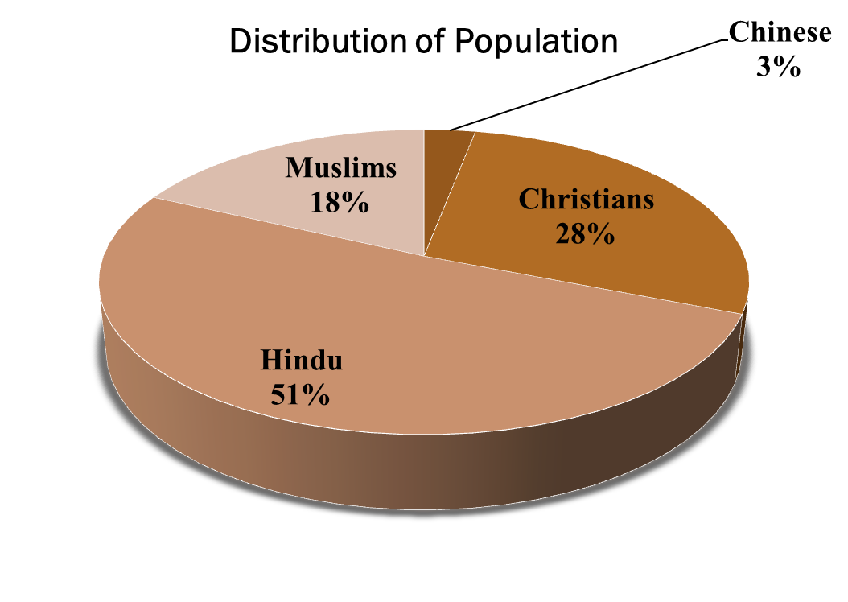
Geographical Background & Muslims in Mauritius
Mauritius - gateway to Africa, South Asia & Asia
Multi-religious society/Democratic
Population: 1.3 M

Slide 18
Geographical Background & Muslims in Mauritius
Muslims presence in all walks of life: Islamic schools, professionals, orphanage, business, politics, etc.
Muslims have contributed enormously in the development of the economy.
But as a community, little efforts have been done to establish the financial system of Islam.
  In 1990’s, there was a keen desire by Muslims to establish an Islamic bank in Mauritius.
  To become part of the Islamic Finance global phenomena.
  Preliminary work carried out: Research - Different Laws, Coop
  Formation of an Islamic Financial Cooperative/Credit Union in the Cooperative sector AL BARAKAH

Slide 19
Formation of AL BARAKAH
Legal Framework
    Registered on 10th June 1998 under the Co-op Societies Act 2016
    Operates:
    Within the Co-operative Societies Act 2016, its rules, regulations and policies;
    In accordance with Islamic Financial principles.
  Objectives
    To provide an alternative to the interest-based financial institutions for the community.
    To provide savings and halal investment opportunities.
    To create a source of credit for its members for provident and productive purposes.
    To promote the welfare and economic interest of its members

Slide 20
Activities
  Main activity- Providing Islamic Financial services –
  Murabahah,Istisna – schemes
  Hajj Savings Account, Multiplier Savings Account ( Mudarabah )
  Investment with members based on Musharakah
  Internal Micro Takaful Ta’awuni Fund
  Creating awareness about Islamic Finance by organizing lectures, training, seminars, conferences, workshop, trade fairs
  Organizing Umrah
Coming projects In sha Allah
  AB Zakah Fund
  Halal Tourism
  Takaful Ta’awuni
  Opportunities with AL BARAKAH for Projects in Mauritius

Slide 21
CONCLUSION
Global efforts over the past 35 years to set up Islamic Micro Finance Co-operatives: T&T, Canada, Cameroun, Malaysia, Indonesia, Thailand, Tanzania, Kenya, Nigeria, India, USA, Australia, Pakistan, S. Lanka, Singapore, Afghanistan …
IFC is in line with both cooperative and Islamic principles.
An effective role in the life of the community by providing access to financial services to all strata of the community and to join the institution.
It will provide members of the community opportunities to manage the wealth of the community in a Shari’ah compliant manner.
Setting up IFC will assist to build up a robust community-based financial institution.
The IFC/ICU can embark everyone on board as a stakeholder in the project.
Finally it will be the job of everybody for the good of society.
Islamic Microfinance Cooperatives To Meet The Financial Needs Of The Community

Slide 22
Jazak Allah
Thank You
Islamic Microfinance Cooperatives To Meet The Financial Needs Of The Community
Mr. Mamode Raffick Nabee Mohomed
Founder & Secretary
AL BARAKAH MCSL
E-mail: albarakahcoop@yahoo.com
rafficknm@yahoo.com
www.albarakahcoop.org
Tel: (+230) 6275766, (+230) 57781738

